Slide 1
Fake News Detection on
Social Media Platform
Supervised By
Dr.Ajay Kumar
Mukund (2210990587) Priyansh(2210990684)
Paramveer(2210990636) Piyush(2210992039)
Department of Computer Science and Engineering, Chitkara University, Punjab

Slide 2
Introduction
Social media platforms like Facebook, Twitter, and WhatsApp have transformed how people consume news
However, this has led to a rapid soread of fake news and misinformation
Fake news spreads 6–10 times faster than real news due to emotional and sensational content.
Manual fact-checking is not scalable due to millions of daily posts.
Machine Learning (ML) and Natural Language Processing (NLP) provide automated solutions for detecting fake news.

Slide 3
Objective
To develop an automated fake news detection system.
To use TF-IDF for feature extraction and Passive Aggressive Classifier (PAC) for classification.
To achieve high accuracy with low computational cost.
To compare the proposed model with other classifiers like:
Naive Bayes
Logistic Regression
Linear SVM
To provide interpretable insights into fake vs real news.

Slide 4
Problem Statement
Fake news spreads rapidly and influences:
Public opinion
Elections
Health decisions (e.g., COVID misinformation)
Human verification is:
Time-consuming
Not scalable
Existing methods:
Deep learning → High accuracy but expensive
Rule-based → Limited performance
Need for a system that is:
Accurate
Fast
Scalable

Slide 5
Methodology
📌 Dataset
ISOT Fake News Dataset
~44,000 articles (Fake + Real)
Balanced distribution (47% fake, 53% real)
📌 Steps:
Text Preprocessing
Lowercasing, removing URLs, punctuation
Tokenization & stopword removal
2. Feature Extraction
TF-IDF (Term Frequency–Inverse Document Frequency)
Converts text into numerical vectors
3. Model Used
Passive Aggressive Classifier (PAC)
Online learning algorithm (updates continuously)
4. Evaluation Metrics
Accuracy
Precision
Recall
F1-score
ROC-AUC

Slide 6
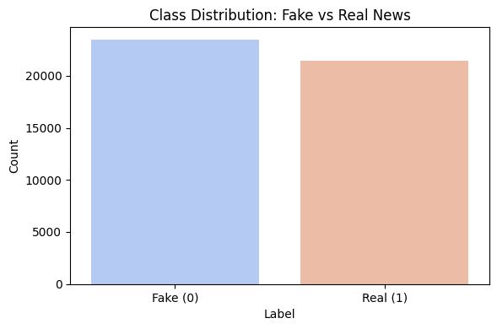
Class Distribution

Slide 7
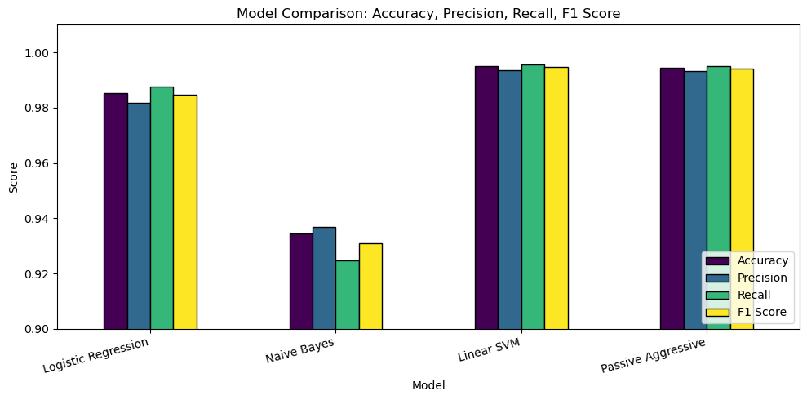
Model comparison

Slide 8
Results & Discussion
Model Performance (ISOT Dataset)
Achieved 99.4% Accuracy, outperforming all baseline models
Precision: 99.3% | Recall: 99.5% | F1-Score: 99.4%
Consistent results with 5-fold cross-validation (99.58% ± 0.03%)
Efficiency & Scalability
Training Time: 31.6 seconds (CPU-based)
~2.7× faster than Linear SVM with higher accuracy
Inference Speed: 0.17 ms/article (~5800 articles/sec)
Suitable for real-time social media monitoring systems
Key Observations (Feature Insights)
Fake News Indicators:
Sensational & emotional words
Examples: “breaking”, “shocking”, “exclusive”
Real News Indicators:
Attribution-based language
Examples: “said”, “according”, “official”

Slide 9
Conclusion
The proposed TF-IDF + PAC model is:
Highly accurate
Computationally efficient
Scalable for real-time use
Outperforms traditional models in:
Accuracy
Speed
Key takeaway:
Simple ML models can outperform complex models when
optimized properly
Future improvements:
Multimodal detection (text + images + videos)
Cross-lingual support
Better handling of evolving fake news

Slide 10
Thank You
3

